Slide 1
Word-in-Context Disambiguation
NLP Homework 1 July 2021 Olga Sorokoletova, 1937430

Slide 2
Overview
Given: Word-in-Context Disambiguation task
Word-level approach
Sequence encoding approach
Goal: Obtain the best-performing model (in terms of accuracy)
A priori
Exploit potential power of the sequence encoding approach
Models:
Baseline
Baseline 2
2a
2b

Slide 3
Baseline
Pre-processing

Slide 4
Given: 'Over 5,000 now hold legal immigrant documents, which, after five years of annual renewal, entitles the holder to apply for permanent residence.'
Pre-processing: Single sentence processing
Numbers Removal
Punctuation Removal
Lower Casing
Tokenization
Stop words removal
Over , now hold legal immigrant documents, which, after five years of annual renewal, entitles the holder to apply for permanent residence.
Over now hold legal immigrant documents which after five years of annual renewal entitles the holder to apply for permanent residence
over now hold legal immigrant documents which after five years of annual renewal entitles the holder to apply for permanent residence
['over', 'now', 'hold', 'legal', 'immigrant', 'documents', 'which', 'after', 'five', 'years', 'of', 'annual', 'renewal', 'entitles', 'the', 'holder', 'to', 'apply', 'for', 'permanent', 'residence']
['hold', 'legal', 'immigrant', 'documents', 'five', 'years', 'annual', 'renewal', 'entitles', 'holder', 'apply', 'permanent', 'residence']

Slide 5
Stop words removal problem
Pre-processing: Single sentence processing
Before:
'At the police station he did not make any such claims, but had alleged torture only at the district court trials.'
After:
['police', 'station', 'make', 'claims', 'alleged', 'torture', 'district', 'court', 'trials']
Needs to be manually corrected!

Slide 6
Embeddings
Pre-processing: Single sentence processing
Compute mean
GloVe 50d
['hold', 'legal', 'immigrant', 'documents', 'five', 'years', 'annual', 'renewal', 'entitles', 'holder', 'apply', 'permanent', 'residence']
[embedding('hold)', embedding( 'legal'), embedding('immigrant'),...]
[ 0.3866, -0.2908, -0.1011, 0.1910, 0.1187, 0.1503, 0.1034, 0.3662, 0.2403, -0.2460, -0.2139, -0.4824, -0.3774, -0.4342, 0.5688, -0.1132,...]
50d tensor of numbers

Slide 7
Pre-processing: Join
'sentence1': 'This growth is the direct result of the increased number of baccalaureate holders, who form the potential market for higher education.'
'sentence2': 'Over 5,000 now hold legal immigrant documents, which, after five years of annual renewal, entitles the holder to apply for permanent residence.'
'.'
[0.1160, 0.3436, 0.2790,...]
50d tensor of numbers
[1.5164e-01, 3.0177e-01, -1.6763e-01,...]
50d tensor of numbers
[-0.0470, 0.5142, -0.0584,...]
50d tensor of numbers
[0.1160, 0.3436, 0.2790,..., 1.5164e-01, 3.0177e-01, -1.6763e-01,...,-0.0470, 0.5142, -0.0584,...]
150d tensor of numbers

Slide 8
Baseline
Model

Slide 9
Model
Architecture
Hyper-parameters
Epochs | 50
ES patience | 7
ES threshold | 0.009
Batch size | 64
Embedding dim | 50
N features | 150
N hidden units | 128
N hidden layers | 2
Activation | ReLU
Optimizer | Adam
Learning Rate | 0.0001
Linear(150, 128)
Linear(128, 128)
Linear(128, 1)

Slide 10
Baseline
Performance

Slide 11
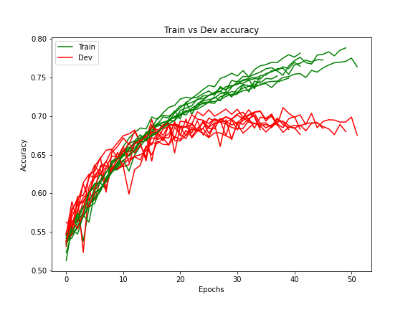
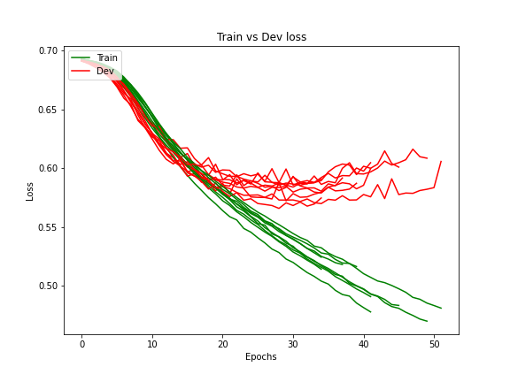
Over 10 independent runs
Performance: Training vs Validation Accuracy and Loss
Best accuracy: 0.7236
Problem: Overfitting about 30-40 epoch (regularization does not help!)

Slide 12
Baseline 2
Pre-processing

Slide 13
Given: 'It will place as many demands on our material resources as on our intellectual capabilities.'
Pre-processing: Single sentence processing
Numbers Removal
Punctuation Removal
Lower Casing
Tokenization
Stop words removal
Lemmatization
['place', 'many', 'demands', 'material', 'resources', 'intellectual', 'capabilities']
['place', 'many', 'demand', 'material', 'resource', 'intellectual', 'capability']

Slide 14
Pre-processing: Join
'sentence1': 'This growth is the direct result of the increased number of baccalaureate holders, who form the potential market for higher education.'
'sentence2': 'Over 5,000 now hold legal immigrant documents, which, after five years of annual renewal, entitles the holder to apply for permanent residence.'
'.'
['growth', 'direct', 'result', 'increased', 'number', 'baccalaureate', 'holder', 'form', 'potential', 'market', 'higher', 'education']
['.']
['hold', 'legal', 'immigrant', 'document', 'five', 'year', 'annual', 'renewal', 'entitles', 'holder', 'apply', 'permanent', 'residence']
['growth', 'direct', 'result', 'increased', 'number', 'baccalaureate', 'holder', 'form', 'potential', 'market', 'higher', 'education',
'.',
'hold', 'legal', 'immigrant', 'document', 'five', 'year', 'annual', 'renewal', 'entitles', 'holder', 'apply', 'permanent', 'residence']

Slide 15
Pre-processing: Prepare input for RNN
['growth', 'direct', 'result', 'increased', 'number', 'baccalaureate', 'holder', 'form', 'potential', 'market', 'higher', 'education', '.', 'hold', 'legal', 'immigrant', 'document', 'five', 'year', 'annual', 'renewal', 'entitles', 'holder', 'apply', 'permanent', 'residence']
Indexed vocabulary with 2 special indices:
0 - for padding token
1 - for Out-of-Vocabulary
[554, 1496, 714, 1043, 225, 31822, 6101, 685, 1158, 213, 611, 633, 4, 804, 832, 5660, 2883, 176, 64, 942, 9239, 53808, 6101, 3517, 2275, 3700, 0, 0, …, 0]
[embedding(554), embedding(1496),…, embedding(0)]
Padding of a sequence with ML - L zeros:
ML - max length of a sequence in the batch
L - length of the current sequence
50 x ML tensor of numbers
GloVe 50d
(random for 0 and 1)

Slide 16
Baseline 2
Model

Slide 17
Model
Hyper-parameters
Architecture
Epochs | 70
ES patience | 7
ES threshold | 0.01
Batch size | 256
Embedding dim | 50
N features | 50
N hidden units | 128
N LSTM cells | 1
Activation | ReLU
Optimizer | Adam
Learning Rate | 0.0001
Decay Rate | 0.000001
Dropout Rate | 0.0
Embedding(400002, 50)
LSTM(50, 128)
Linear(128, 128)
Linear(128, 1)

Slide 18
Baseline 2
Performance

Slide 19
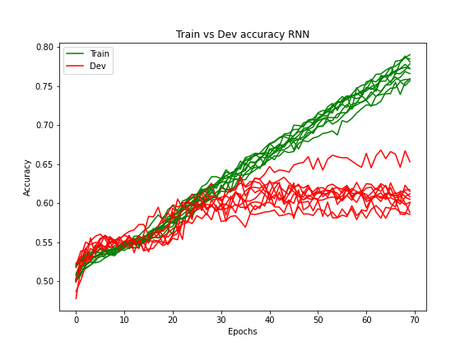
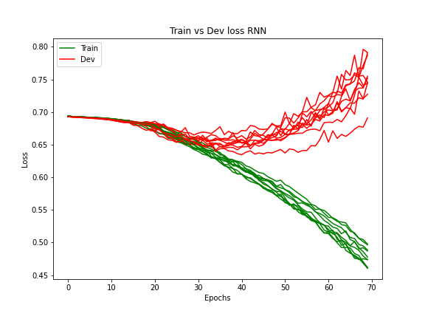
Over 10 independent runs
Performance: Training vs Validation Accuracy and Loss
Best accuracy: 0.6681 (vs 0.7236 we had before)
Problem: Overfitting about 50 epoch

Slide 20
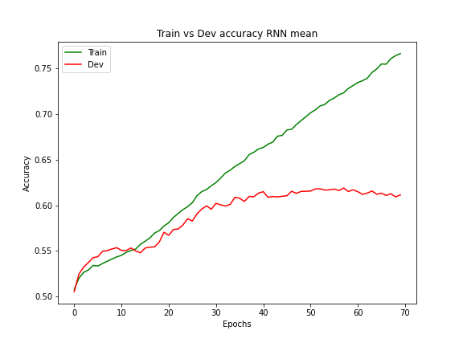
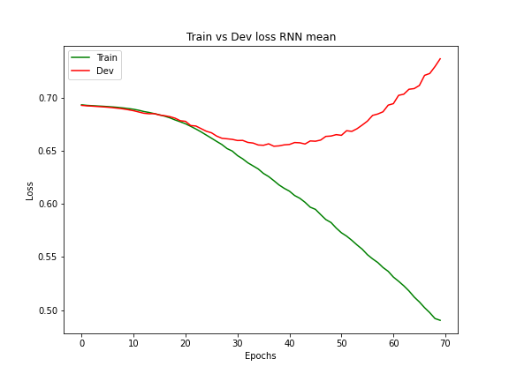
Averaged over 10 independent runs
Performance: Averaged graphs
Accuracy: got stabilized about 0.60 (vs 0.66 the best accuracy)
Problem: overfitting, the best performance achieved by lucky initialization
model is result
of a lucky initialization.

Slide 21
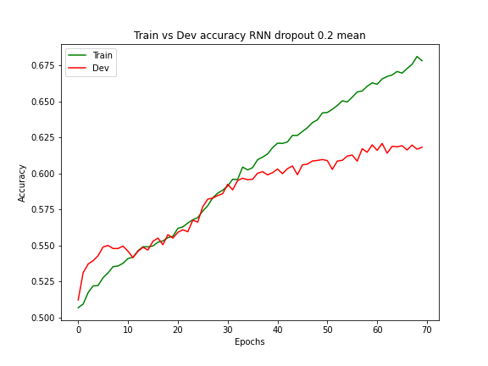
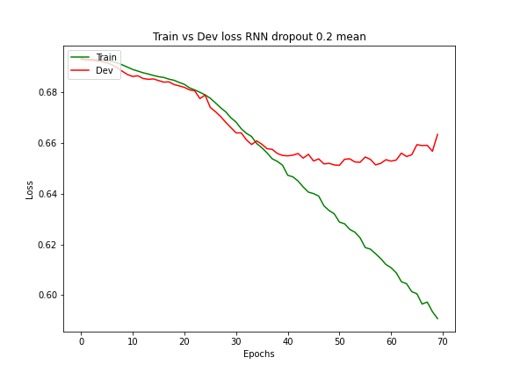
Averaged over 10 independent runs, p = 0.2, 2 LSTM layers, dropout applied after embedding layer, between 2 LSTMs and after them
Performance: Add dropout
Accuracy: got stabilized about 0.62 (vs 0.60 without dropout)
Problem: overfitting, but less obvious

Slide 22
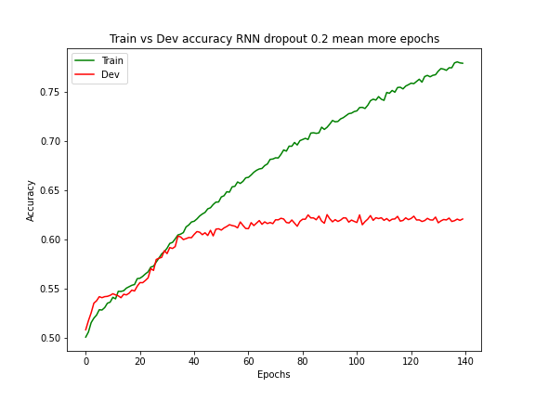
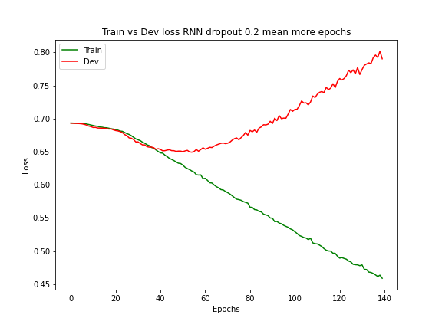
Averaged over 10 independent runs, p = 0.2, 2 LSTM layers, dropout applied after embedding layer, between 2 LSTMs and after them, 140 epochs of training
Performance: More epochs
Accuracy: got stabilized about 0.62 (vs 0.62)
Problem: overfitting, now it is obvious

Slide 23
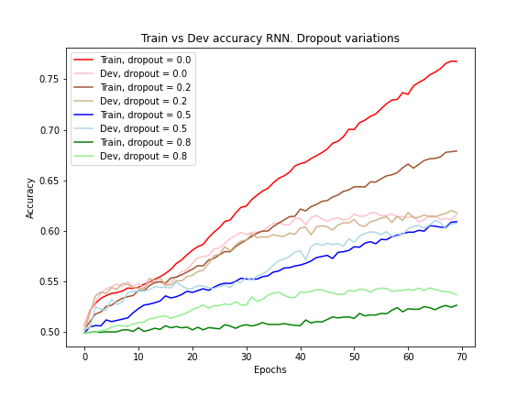
Averaged over 10 independent runs
Performance: Dropout variations
Accuracy: got stabilized about 0.62 or less
Problem: overfitting, and dropout variation does not help

Slide 24
2a
Pre-processing and Model

Slide 25
Pre-processing and Model: differences with Baseline 2
Pre-processing
Model
Need to keep index of the target word in the sequence of indices (additionally to an index of the last not padding token)
Extract two sequence encodings: corresponding to the representation of a whole sentence and corresponding to the target word
Double-labeling

Slide 26
2a
Performance

Slide 27
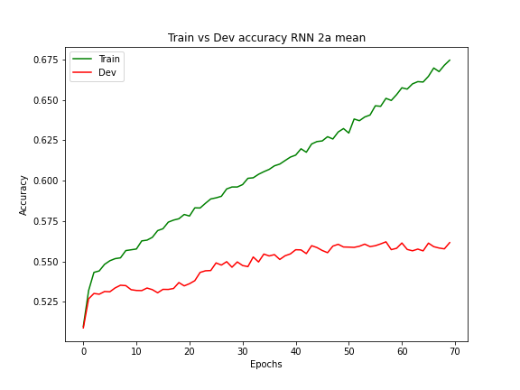
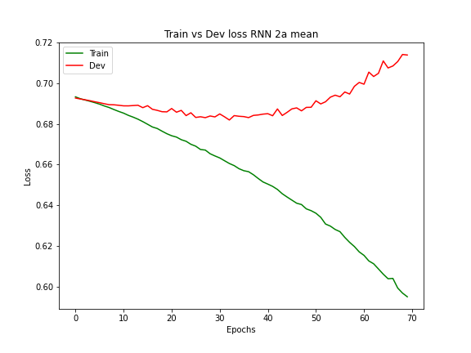
Averaged over 10 independent runs
Performance: Training vs Validation Accuracy and Loss
Best accuracy: 0.5776 (vs 0.6681 we had for Baseline 2)
Problem: improvement is not achieved

Slide 28
2b
Idea

Slide 29
2b
The underlying idea of this model was to perform binary classification over the following representation of the training data:
Best accuracy: 0.5773 - comparable with 2a, but not comparable with Baseline 2
Feature 1 | Feature 2 | Feature 3 | Feature 4 | Label
whole sequence encoding for the sentence 1 | sequence encoding corresponding to the target word in the sentence 1 | whole sequence encoding for the sentence 2 | sequence encoding corresponding to the target word in the sentence 2 | gt label

Slide 30
Conclusion

Slide 31
Even if sequence encoding approach is potentially more powerful, sometimes simpler approach can be better performing;
Handling overfitting is a challenging task, and in our case standard regularization techniques did not help. Therefore, some more sophisticated approaches either to it or to the model architecture design/way of pre-processing are needed;
However, the best performing model achieved quite decent performance by means of common NLP practices for the pre-processing.

